Slide 1


Hii,
Iam Siddhika
Welcome to Power BI Series
Part -50

Slide 2



We focus only on the most used and important Dax Functions
Today Content
Meet DAX
I’m soo Excited. It’s my favourite functions.
Are you ready guys?
COMMON FUNCTION CATEGORIES
7.TIME INTELLIGENCE FUNCTIONS(FEW MORE)
PARALLELPERIOD
SAMEPERIODLASTYEAR PARALLELPERIOD Vs
SAMEPERIODLASTYEAR

Slide 3


PARALLELPERIOD
The PARALLELPERIOD function in DAX returns a table that contains a column of dates shifted by a specified number of intervals. This function is commonly used to compare measures across different time periods, such as months, quarters, or years.
Check this
Syntax
PARALLELPERIOD(<dates>,<number_of_intervals>,<interval>)
dates: A column containing dates.
number_of_intervals: The number of intervals to shift the dates. interval: The interval by which to shift the dates. It can be DAY, MONTH, QUARTER, or YEAR.
Year interval: Compares data across years, shifting the date context by a specified number of years.
Month interval: Compares data across months, shifting the date context by a specified number of months.
Quarter interval: Compares data across quarters, shifting the date context by a specified number of quarters.
Day interval: Compares data across days, shifting the date context by a specified number of days.

Slide 4
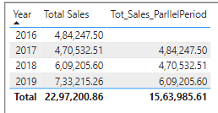

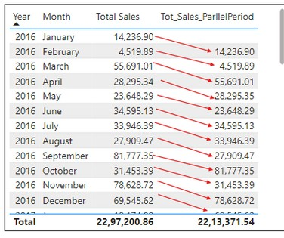

VISUAL EXAMPLE FOR BETTER UNDERSTANDING
How can you create a measure to calculate the total sales amount for the last year using the Orders table and the OrderDate column? taking year as Intervel
Easy?
Total sales Parllelperiod column for 2017 gives the sales amount of 2016, for 2018 gives the sales amount of 2017 .
It gives the sales amount of last year.
Creating a Measure to Get Sales of the Previous Month
January 2016: No previous month data available, so the measure returns blank.
February 2016: Previous month is January 2016, so it shows 14,236,90. March 2016: Previous month is February 2016, so it shows 4,519,89 and goes on...

Slide 5

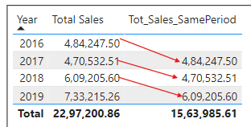
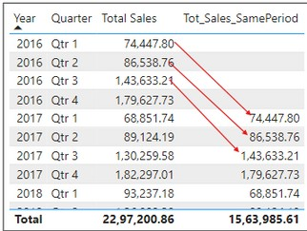
SAMEPERIODLASTYEAR
The SAMEPERIODLASTYEAR function in DAX returns a table that contains a column of dates representing the same period in the previous year.
This function is useful for year-over-year comparisons of measures like sales, revenue, and other time-dependent metrics.
Got it?
Syntax
Example
SAMEPERIODLASTYEAR(<dates>)
How can you create a measure to calculate the total sales amount for the same period last year using the Orders table and the OrderDate column?
This function also works with row context, such as when you add quarters to the hierarchy. For instance, it will compare Q1 2017 with Q1 2016.
It do the same with month and day.
Gives exact 1 year back
it will display the total sales for the same period in the previous year.

Slide 6
PARALLELPERIOD VS SAMEPERIODLASTYEAR
Both PARALLELPERIOD and SAMEPERIODLASTYEAR functions are used in DAX for time intelligence calculations, but they serve different purposes and have distinct behaviors.
PARALLELPERIOD SAMEPERIODLASTYEAR
cleared?
Shifts the dates by a specified
Returns a table with the same period in the previous year.
number of intervals (months, quarters, or years).
Flexible for moving the date range by different intervals, not limited to just one year.
Can move the date range forward or backward by a specified number of intervals.
Ideal for year-over-year comparisons.
Always moves the date range exactly one year back.
The PARALLELPERIOD function provides more flexibility than SAMEPERIODLASTYEAR. While SAMEPERIODLASTYEAR is limited to comparing the same period in the previous year, PARALLELPERIOD allows you to define the interval and the number of intervals you want to go back or forward. This makes PARALLELPERIOD more versatile for different types of time- based analyses.

Slide 7


Thank you for joining me today to learn about Part -50 of Power BI!
Remember, Learning DAX is key to unlocking the full potential of Power BI for insightful reporting and visualization.
Stay tuned for more insights and tips on Power BI in our next Series.
Follow
Siddhika Shah

